Slide 1
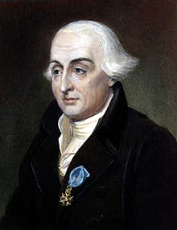
Joseph-Louis Lagrange
Lagrange Points and the three-body problem

Slide 2
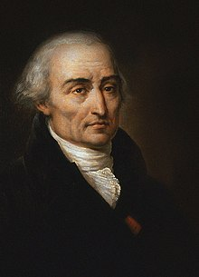
Joseph-Louis Lagrange
Lagrange was born in 1736 in what is now modern-day Italy.
Made many contributions to math and science in fields such as mechanics, calculus, and celestial mechanics.
Created a method of solving for extrema of functions known as Lagrange Multipliers.
Made a variation of Newtonian mechanics aptly named Lagrangian mechanics. It is an analysis from the perspective of energies rather than forces.
Discovered points of equilibrium around orbiting bodies know as Lagrange Points

Slide 3
Three-Body Problem
The three-body problem is the problem of taking three masses and solving for their positions at any time.
There is no closed solution to this problem (no solution that can be written with a finite number of terms).
The restricted three body-problem is where one of the masses is small enough such that it has negligible effect on the other two masses (think Sun – Earth – Satellite system).
The restricted three body-problem does have a closed solution.

Slide 4
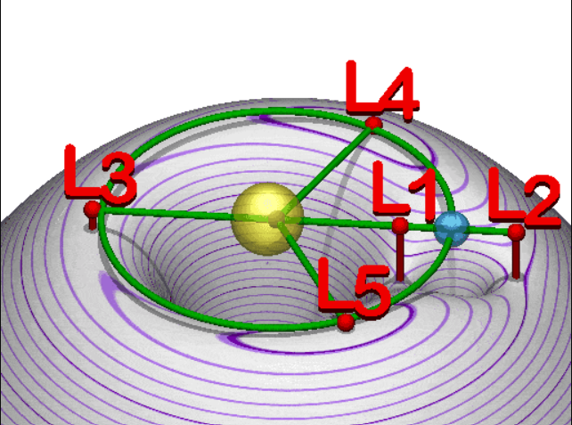
Lagrange Points
Lagrange Points are solutions to the restricted three-body problem
In simple terms, they are where the gravity of the two main bodies (Sun and Earth) cancel out.
In more complex terms, Lagrange Points occur at the local extrema of the net effective potential of gravity and the apparent centrifugal force.
L1, L2, and L3 are saddle points and therefore unstable, but objects can be kept there with slight orbital corrections.
L4 and L5 are maximum but are actually completely stable. This is because if they start to move away, the Coriolis force pushes them back.

Slide 5
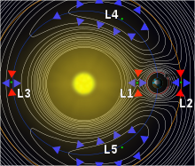
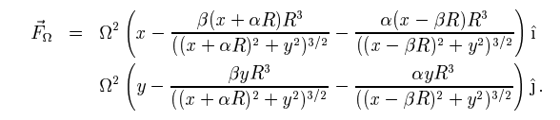
Finding the Lagrange Points
You could solve for the local extrema using Lagrange Multipliers. I could not find, however, anyone who solved it in this manner.
The best I could find was a paper with some intense math that I do not fully understand. Example:
The James Webb Space Telescope actually orbits around L2 and allows it to stay in constant communication with Earth.

Slide 6
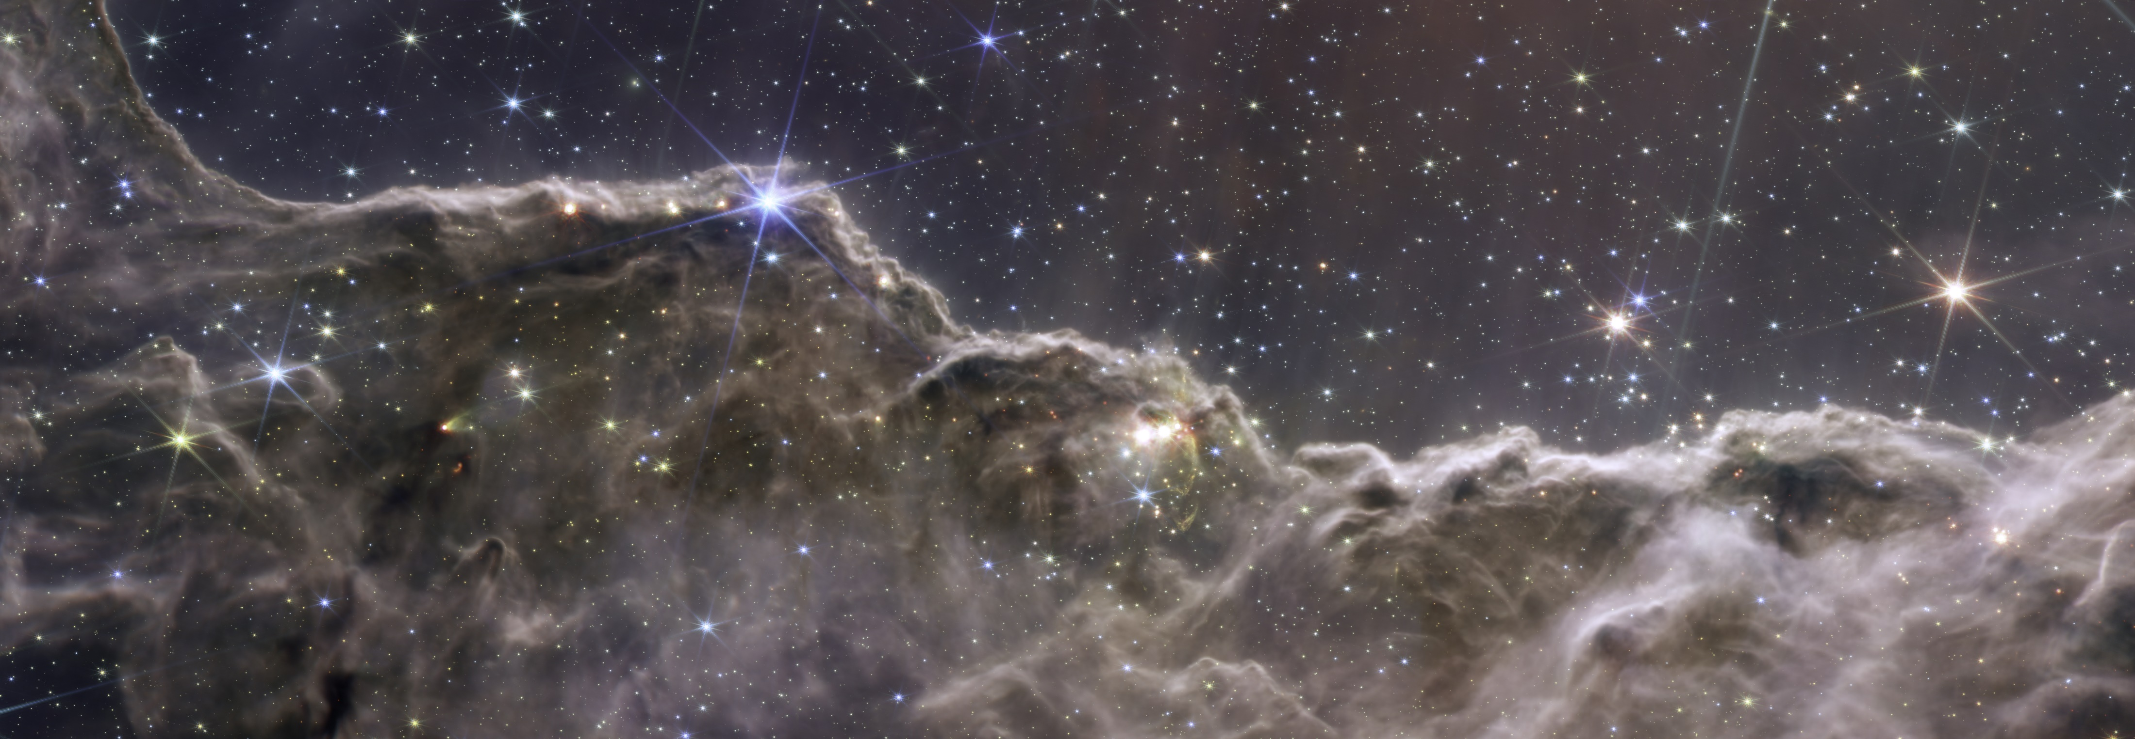
References and Additional Resources
Lagrange Wikipedia: https://en.wikipedia.org/wiki/Joseph-Louis_Lagrange
Three-Body Problem: https://en.wikipedia.org/wiki/Three-body_problem
Cheesy but Informative Explanation of Lagrange Points: https://www.youtube.com/watch?v=2LjGgJ4ST60
Neil DeGrasse Tyson explaining Lagrange Points: https://www.youtube.com/watch?v=E_eTO3ujD4w
Math Paper Calculating Lagrange Points: https://web.archive.org/web/20150907090116/http://www.physics.montana.edu/faculty/cornish/lagrange.pdf
JWST Picture ->

